Slide 1
MINI PROJECT
DBMS 1 & DBMS 2
PROJECT GROUP 3
RuSHIKA Ramesh Gade
Nikhil Rajesh Chauhan
Marre Devipriya

Slide 2
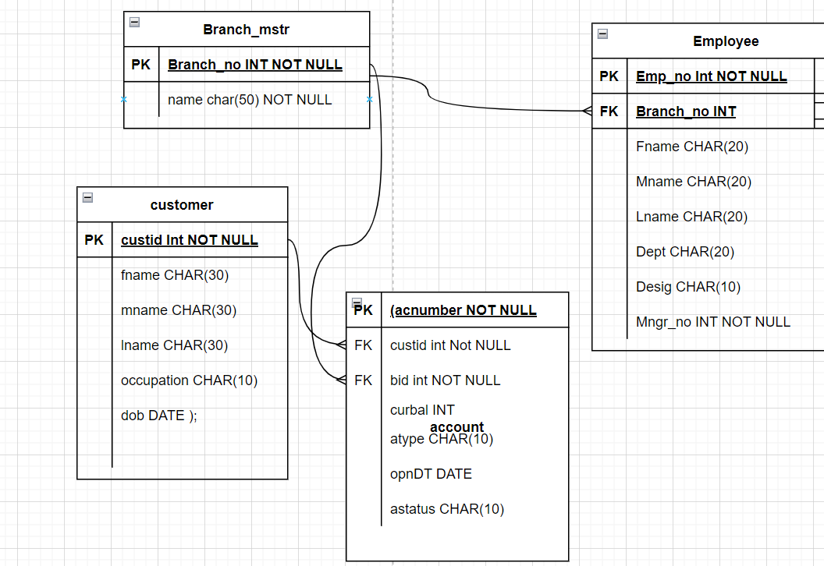
Case Study 1: Retail Banking
The retail banking business model maintains records of Branch, Employees, Customers and Accounts as follows,

Slide 3
Case Study 1: Retail Banking
Project Questions:
Create DataBase BANK and Write SQL query to create above schema with constraints
CREATE DATABASE BANK;
USE BANK;
CREATE TABLE account ( acnumber INT NOT NULL, custid INT NOT NULL, bid INT NOT NULL, curbal INT, atype CHAR(10), opndt DATE, astatus CHAR (10) );
CREATE TABLE branch ( branch_no INT NOT NULL, name CHAR(50) NOT NULL );
CREATE TABLE employee ( emp_no INT NOT NULL, branch_no INT, fname CHAR(20), mname CHAR(20), lname CHAR(20), dept CHAR(10), desig CHAR(20), mngr_no INT NOT NULL );
CREATE TABLE customer ( custid INT NOT NULL, fname CHAR(30), mname CHAR(30), lname CHAR(30), occupation CHAR(10), dob DATE );

Slide 4
2. Inserting Records into created tables
INSERT INTO customer (custid, fname, mname, lname, occupation, dob) VALUES (1,'Ramesh','Chandra','Sharma','Service','1976-12-06'), (2,'Avinash','Sunder','Minha','Business','1974-10-16');
INSERT INTO account (acnumber,custid,bid,curbal,opndt,atype,astatus) VALUES (1,1,1,10000,'2012-12-15','Saving','Active'), (2,2,2,5000,'2012-06-12','Saving','Active');
INSERT INTO employee (emp_no,branch_no,fname,mname,lname,dept,desig,mngr_no) VALUES (1,1,'Mark','steve','Lara','Account','Accountant',2), (2,2,'Bella','James','Ronald','Loan','Manager',1);
INSERT INTO branch (branch_no, NAME) VALUES (1, 'DELHI'), (2, 'MUMBAI');

Slide 5
3. Select unique occupation from customer table
SELECT DISTINCT occupation FROM customer;
SELECT DISTINCT: statement is used to return only distinct (different) values from the table.
4. Sort accounts according to current balance
SELECT * FROM account ORDER BY ( curbal ) ASC;
ORDER BY: keyword is used to sort the result-set in ascending or descending order.

Slide 6
5. Find the Date of Birth of customer name ‘Ramesh’
SELECT dob FROM customer WHERE fname = 'RAMESH';
6. Add column city to branch table
ALTER TABLE customer ADD city CHAR(50) NOT NULL;
7. Update the mname and lname of employee ‘Bella’ and set to ‘Karan’, ‘Singh’
UPDATE employee SET mname = 'Karan', lname = 'Singh' WHERE emp_no = 2;

Slide 7
8. Select accounts opened between '2012-07-01' AND '2013-01-01’
SELECT * FROM account WHERE opndt BETWEEN '2012-07-01' AND '2013-01-01';
9. List the names of customers having ‘a’ as the second letter in their names
SELECT * FROM customer WHERE fname LIKE '_a%';

Slide 8
10. Find the lowest balance from customer and account table
SELECT * FROM (SELECT custid, curbal, Row_number() OVER ( ORDER BY curbal ASC) AS rn FROM account)sub WHERE rn = 1;

Slide 9
11. Give the count of customer for each occupation
SELECT occupation, Count(custid) FROM customer GROUP BY occupation;

Slide 10
12. Write a query to find the name (first_name, last_name) of the employees who are managers.
SELECT Concat(fname, lname) AS C_Name, desig FROM employee WHERE desig = 'Manager';

Slide 11
13. List name of all employees whose name ends with a
SELECT emp_no, fname AS C_Name, desig FROM employee WHERE fname LIKE '%a';

Slide 12
14. Select the details of the employee who work either for department ‘loan’ or ‘credit’
SELECT * FROM employee WHERE dept IN ( 'Loan', 'Credit' );

Slide 13
15. Write a query to display the customer number, customer firstname, account number for the
SELECT c.custid, c.fname AS Customer_Firstname, a.acnumber FROM customer c JOIN account a ON c.custid = a.custid;

Slide 14
16. Write a query to display the customer’s number, customer’s firstname, branch id #and balance amount for people using JOIN.
SELECT e.emp_no, e.fname, e.branch_no, a.curbal FROM employee e JOIN account a ON e.emp_no = a.custid;

Slide 15
17. Create a virtual table to store the customers who are having the accounts in the same city as they live
CREATE VIEW cust_city AS (SELECT c.custid, c.fname, c.city, b.NAME AS Branch_City FROM customer c JOIN account a ON c.custid = a.custid JOIN branch b ON b.branch_no = a.bid WHERE c.city = b.NAME);
View theory: a view is a virtual table based on the result-set of an SQL statement.A view contains rows and columns, just like a real table. The fields in a view are fields from one or more real tables in the database.You can add SQL statements and functions to a view and present the data as if the data were coming from one single table.

Slide 16
18. Create a transaction table with following details
TID – transaction ID – Primary key with autoincrement
Custid – customer id (reference from customer table
account no – acoount number (references account table)
bid – Branch id – references branch table
amount – amount in numbers
type – type of transaction (Withdraw or deposit)
DOT - date of transaction
CREATE TABLE t_transaction ( tid INT auto_increment PRIMARY KEY NOT NULL, custid INT, account_no INT, bid INT, amount INT, tot VARCHAR(30), dot DATE ) engine=innodb; ALTER TABLE t_transaction ADD CONSTRAINT custid_key FOREIGN KEY (custid) REFERENCES customer(custid); ALTER TABLE t_transaction ADD CONSTRAINT account_no_key FOREIGN KEY (account_no) REFERENCES account( acnumber); ALTER TABLE t_transaction ADD CONSTRAINT bid_key FOREIGN KEY (bid) REFERENCES branch(branch_no);
Desc t_transaction;

Slide 17
18. a. Write trigger to update balance in account table on Deposit or Withdraw in transaction table
DELIMITER $CREATE TRIGGER fan after INSERT ON t_transaction FOR each row BEGINUPDATE account SET account.curbal=account.curbal+new.amount WHERE account.custid=new.custid AND new.tot='deposit';UPDATE account SET account.curbal=account.curbal-new.amount WHERE account.custid=new.custid AND new.tot='withdraw';END $ delimiter ;
18. b. Insert values in transaction table to show trigger success
INSERT INTO t_transaction VALUES (11,1,1,1,1000,'deposit',CURRENT_DATE(),1);
SELECT * FROM account; SELECT * FROM t_transaction; INSERT INTO t_transaction VALUES (12,2,2,2,1000,'withdraw',CURRENT_DATE(),1); INSERT INTO t_transaction VALUES (13,2,2,2,700,'deposit',CURRENT_DATE(),1);

Slide 18
19. Write a query to display the details of customer with second highest balance
SELECT * FROM (SELECT *, Dense_rank() OVER ( ORDER BY curbal DESC) AS rn FROM account)sub WHERE rn = 2;
Dence rank: DENSE_RANK computes the rank of a row in an ordered group of rows and returns the rank as a NUMBER. The ranks are consecutive integers beginning with 1. The largest rank value is the number of unique values returned by the query. Rank values are not skipped in the event of ties. Rows with equal values for the ranking criteria receive the same rank.

Slide 19
20. Take backup of the databse created in this case study
#BACKUP DATABASE bank#TO DISK = 'E:\Great Lakes\DBMs project';#mysqldump -u [user name] –p [password] -h [host name] [options] [database_name] [tablename] > [dumpfilename.sql]#`
Manually dumped the database onto disk
Click on “Data Export” under the “Management” tab on the left sidebar
You will get a list of available databases.Click on the checkbox next to the database you want to export.
Choose the appropriate option under “Export Options.”
Click on “Start Export.”#You can track the process through “Export Progress.”

Slide 20
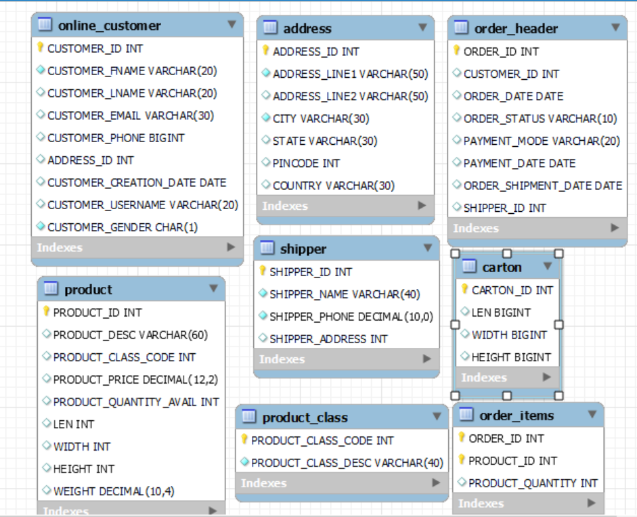
Case Study 2: Customer Case study
Create customer schema with commands given in case study document

Slide 21
1. Display the product details as per the following criteria and sort them in descending order of category:
If the category is 2050, increase the price by 2000
If the category is 2051, increase the price by 500
If the category is 2052, increase the price by 600
SELECT product_desc, product_class_code, product_quantity_avail, len, width, height, weight, product_price, CASE product_class_code WHEN 2050 THEN ( product_price + 2000 ) WHEN 2051 THEN ( product_price + 500 ) WHEN 2052 THEN ( product_price + 600 ) ELSE product_price END AS PRODUCT_PRICE FROM product ORDER BY product_class_code DESC;

Slide 22
Explain Case expression and impact and use
The case expression goes through conditions and returns a value when the first condition is met(like an if-then-else statement)
So once the condition is true, it will stop reading and return the result. If no conditions are true, it returns the value in the ELSE clause
There are two types of CASE expressions they are simple and searched
Syntax of a simple CASE expression:
CASE <common_operand> WHEN <expression> THEN <result> [WHEN <expression> THEN <result> . . .]
[ELSE <result>]
END
Syntax of a searched CASE expression:
WHEN <condition> THEN <result>
[WHEN <condition> THEN <result> . . .]
[ELSE <result>]
END

Slide 23
2. List the product description, class description and price of all products which are shipped.
SELECT p.product_id, p.product_desc, p.product_price, pc.product_class_desc, oh.order_status FROM product_class pc JOIN product p ON pc.product_class_code = p.product_class_code JOIN order_items ot ON p.product_id = ot.product_id JOIN order_header oh ON ot.order_id = oh.order_id WHERE order_status = "shipped";

Slide 24
Define join and explain the scenExplainario how it is working in q2.
A join is a SQL operation performed to establish a connection between two or more database tables based on matching columns, therby creating a relationship between the tables. Most complex queries in an SQL database management system involve join commands
product_class_code attribute used to bind product_class table and product table
product table JOIN order_items product_id
JOIN order_header order_id

Slide 25
3. Show inventory status of products as below as per their available quantity:
For Electronics and Computer categories, if available quantity is < 10, show 'Low stock', 11 < qty < 30, show 'In stock', > 31, show 'Enough stock’
For Stationery and Clothes categories, if qty < 20, show 'Low stock', 21 < qty < 80, show 'In stock', > 81, show 'Enough stock’
Rest of the categories, if qty < 15 – 'Low Stock', 16 < qty < 50 – 'In Stock', > 51 – 'Enough stock’
For all categories, if available quantity is 0, show -'Out of stock’
SELECT pc.product_class_desc, p.product_id, p.product_desc, p.product_quantity_avail, CASE WHEN p.product_quantity_avail = 0 THEN 'Out of stock' WHEN pc.product_class_desc IN ( 'Electronics', 'Computer' ) THEN CASE WHEN p.product_quantity_avail <= 10 THEN 'Low stock' WHEN p.product_quantity_avail BETWEEN 11 AND 30 THEN 'In stock' WHEN p.product_quantity_avail >= 31 THEN 'Enough stock' END WHEN pc.product_class_desc IN ( 'Stationery', 'Clothes' ) THEN CASE WHEN p.product_quantity_avail <= 20 THEN 'Low stock' WHEN p.product_quantity_avail BETWEEN 21 AND 80 THEN 'In stock' WHEN p.product_quantity_avail >= 81 THEN 'Enough stock' END WHEN pc.product_class_desc NOT IN ( 'Stationery', 'Clothes', 'Electronics', 'Computer' ) THEN CASE WHEN p.product_quantity_avail <= 15 THEN 'Low stock' WHEN p.product_quantity_avail BETWEEN 16 AND 50 THEN 'In stock' WHEN p.product_quantity_avail >= 51 THEN 'Enough stock' END END AS status FROM product p INNER JOIN product_class pc ON product_id = product_id;

Slide 26
4. List customers from outside Karnataka who haven’t bought any toys or books
SELECT customer_id FROM online_customer WHERE address_id NOT IN (SELECT address_id FROM address WHERE state != 'Karnataka') AND customer_id NOT IN (SELECT customer_id FROM order_items JOIN order_header ON order_items.order_id = order_header.order_id WHERE product_id IN (SELECT product_id FROM product_class WHERE product_class_code IN ( SELECT product_class_code FROM product_class WHERE product_class_desc IN ( 'Toys', 'Books' )) ))

Slide 27
Explain join and subquery and 1 to many relationship
A join is a SQL operation performed to establish a connection between two or more database tables based on matching columns, therby creating a relationship between the tables.
Subquery can be simply defined as a query within another query. In other words we can say that a subquery is a query that is embedded in WHERE clause of another SQL query.
In relational database, a one to many relationship occurs when a parent record in one table can potentially reference several child records in another table

Slide 28
THANK YOU

